Slide 1

IMDB Top Rated Action Movies
Properly prepared
Team: Afhy,uday,isi, reddy,remre

Slide 2
The Link of the Python Code
https://deepnote.com/project/StringsFiles-p-qDCKsjSTmCBGqURa71_Q/%2Fnotebook.ipynb#00001-73c88873-4a04-419c-99b9-4f4448a47f78

Slide 3
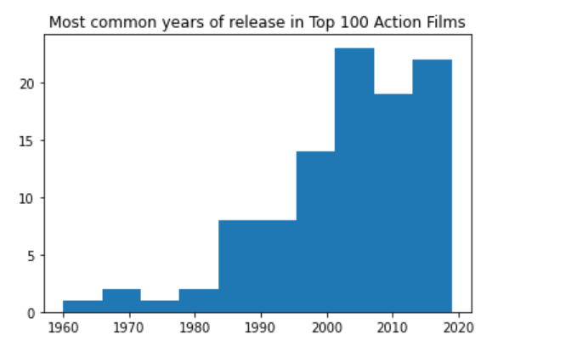
Most Common Years of Release in Top 100 Action Films

Slide 4
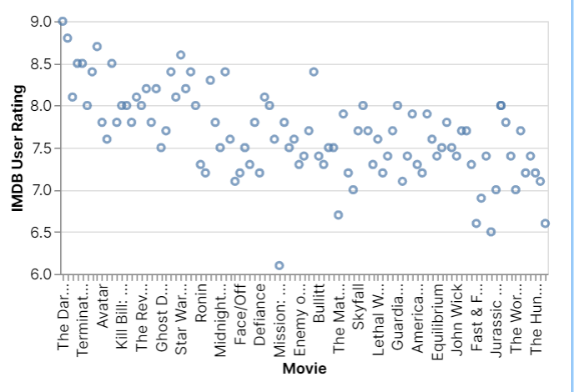
IMDB User Rating

Slide 5
